Slide 1

CAPSTONE PROJECT PROJECT TITLE
Anomaly Detection with Autoencoders
Presented By
Student Name:YASMEEN BEGUM
College Name:UNIVERSITY COLLEGE OF ENGINEERING,OSMANIA UNIVERSITY
Department:Mtech-aiml
Email ID:yasmeen87151@gmail.com
AICTE Student ID:STU6129d0829cc1b1630130306

Slide 2
OUTLINE
Problem Statement
Proposed System/Solution
System Development Approach (Technology Used)
Algorithm & Deployment
Result (Output Image)
Conclusion
Future Scope
References

Slide 3
Problem Statement
Most anomaly detection methods rely on labeled data, which is often limited or unavailable.The objective is to detect anomalies in an unsupervised way by learning normal data patterns.We use autoencoders to identify deviations through reconstruction errors.

Slide 4
Proposed Solution
The proposed system addresses the challenge of detecting anomalies in unlabeled datasets using autoencoders. This deep learning approach learns normal data patterns and flags deviations based on reconstruction error. The solution consists of the folloing components:
Data Collection: -Gather a dataset representative of normal and anomalous behavior (e.g., credit card transactions, sensor logs). -Ensure data contains key attributes relevant to detecting deviations (e.g., amount, frequency, timing).
Data Preprocessing: -Clean and normalize the data to ensure consistent input for the model. -Split data into training (normal only) and testing (mixed) sets.
Model Development: -Design and train an autoencoder neural network to learn compressed representations of normal data. -Use reconstruction error to measure how well the model recreates inputs — higher errors indicate potential anomalies.
Anomaly Detection: -Set a threshold for reconstruction error using the validation set. -Classify inputs as normal or anomalous based on whether their error exceeds this threshold.
Evaluation:. -Visualize reconstruction error distributions to assess model effectiveness.

Slide 5
System Approach
System Requirements:
Editor:Kaggle Notebook
Minimum storage:16GB Ram
Runtime:GPU P100
Libraries Required:
NumPy and Pandas – for data manipulation and preprocessing
Matplotlib and Seaborn – for data visualization
Scikit-learn – for scaling and evaluation metrics
TensorFlow or Keras – for building and training the autoencoder model

Slide 6
Algorithm & Deployment
Algorithm Selection: -An Autoencoder, a type of neural network used for unsupervised learning, is selected for anomaly detection.
-It is well-suited for modeling normal data patterns and identifying deviations through reconstruction error.
-This approach is ideal due to the lack of labeled anomaly data and the high dimensionality of the dataset.
Data Input: -The model takes in numerical input features such as transaction amounts, usage patterns, sensor readings, or time-based attributes.
-All features are normalized to ensure efficient learning and prevent scale-based bias.
Training Process: -The autoencoder is trained exclusively on normal (non-anomalous) data to learn a compressed representation.
Loss Function:
- Mean Squared Error (MSE) is used to minimize reconstruction loss.
Optimization:
-Techniques like early stopping, learning rate scheduling, and dropout are applied to improve generalization.
Validation:
-A separate validation set is used to determine the optimal threshold for reconstruction error.
Prediction Process: -In the inference phase, the trained model reconstructs each input.
-The reconstruction error is calculated for each input.
-If the error exceeds the predefined threshold, the data point is flagged as an anomaly.
-This process supports real-time detection in streaming or batch environments.

Slide 7
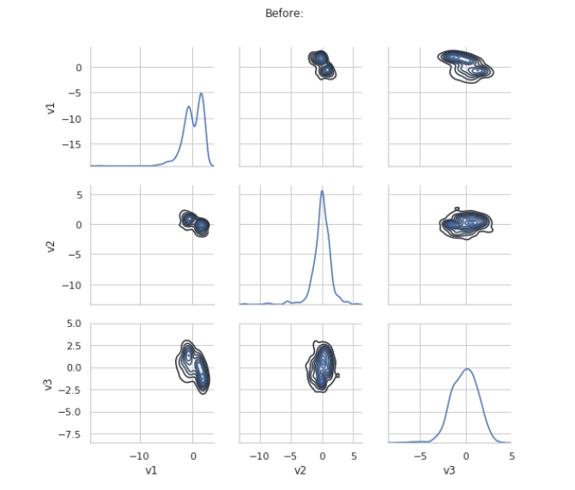
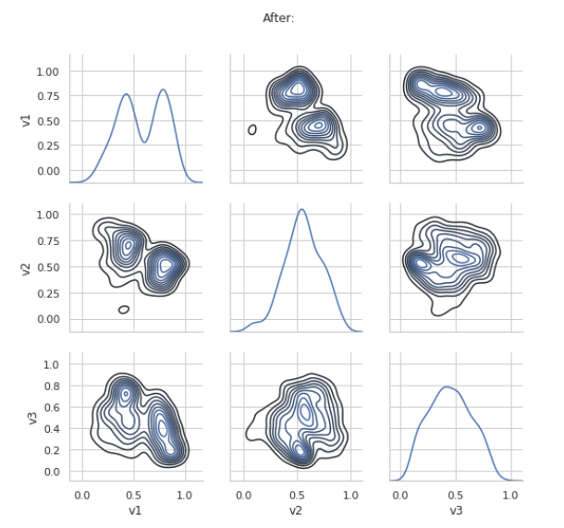
Result

Slide 8
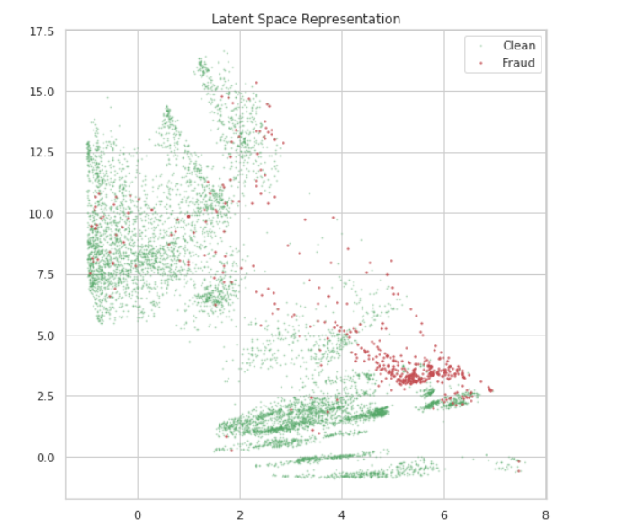
Result

Slide 9
Conclusion
Autoencoders provide an effective unsupervised approach to anomaly detection by learning patterns of normal data.
Reconstruction error serves as a reliable metric to identify deviations without needing labeled anomalies.
The model is flexible, scalable, and can be adapted to various domains like fraud detection or system monitoring.
Visualization tools like t-SNE enhance interpretability by showing how well anomalies separate from normal data.

Slide 10
Future scope
Enhance anomaly detection accuracy by incorporating more diverse and real-time data sources like IoT sensors, social media, and user feedback.
Develop adaptive models that continuously learn and update from new data to handle evolving patterns and emerging anomaly types.
Extend the system’s application to multiple industries such as healthcare, finance, and manufacturing for broader impact.
Explore edge computing and federated learning to enable real-time, privacy-aware anomaly detection in distributed environments.

Slide 11
References
Chalapathy, R., & Chawla, S. (2019). Deep Learning for Anomaly Detection: A Survey. arXiv preprint arXiv:1901.03407. https://arxiv.org/abs/1901.03407
Sakurada, M., & Yairi, T. (2014). Anomaly Detection Using Autoencoders with Nonlinear Dimensionality Reduction. Proceedings of the MLSDA 2014 2nd Workshop on Machine Learning for Sensory Data Analysis. https://dl.acm.org/doi/10.1145/2689746.2689747
Hinton, G. E., & Salakhutdinov, R. R. (2006). Reducing the Dimensionality of Data with Neural Networks. Science, 313(5786), 504-507. https://science.sciencemag.org/content/313/5786/504
Kingma, D. P., & Welling, M. (2013). Auto-Encoding Variational Bayes. arXiv preprint arXiv:1312.6114. https://arxiv.org/abs/1312.6114
GitHub Link:https://github.com/Yasmeen-Begum/Aicte-edunet-projects/tree/main/4%20-%20week%20Internship%20%20on%20the%20AI%20Azure%20(May%202025%20-%20June%202025)

Slide 12
Thank you

